Slide 1
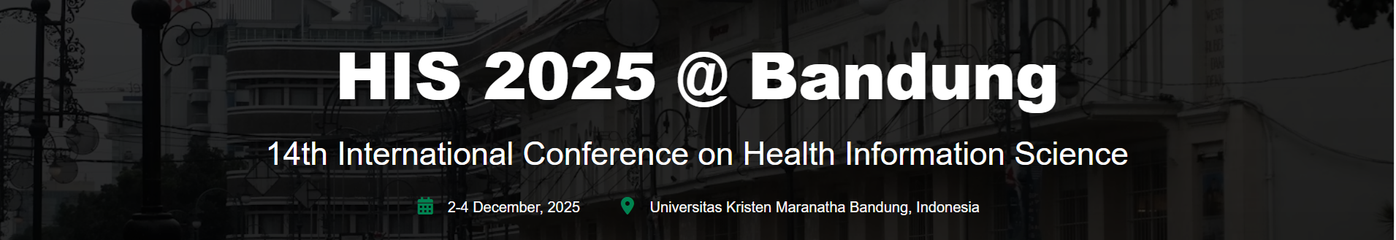
Guidelines on how to get from
Soekarno Hatta Airport to Bandung (Hotels around Pasteur)

Slide 2



1. Shuttle Bus :
Here are several shuttle bus options available at the airport terminal:
Cititrans (recommended)
Jackal Holidays
Lintas Shuttle

Slide 3
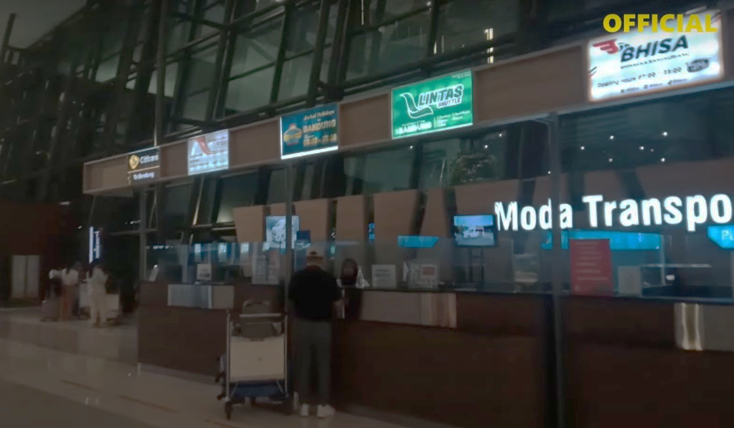
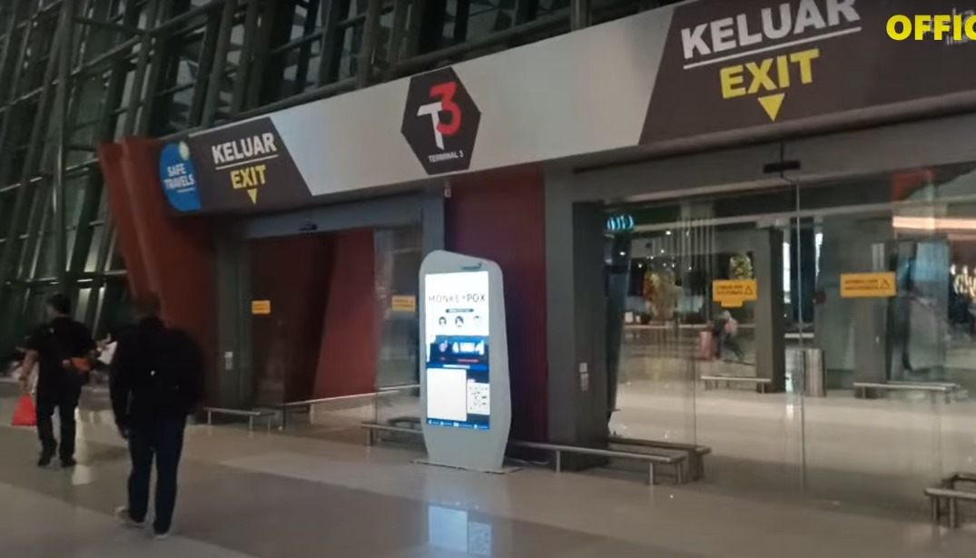
Go to the Shuttle Bus counter at Terminal 3
After reaching the ARRIVAL TERMINAL, exit through GATE 5 then turn left.
Find the MODA TRANSPORTATION counter then buy tickets for the CITITRANS shuttle bus.
Then exit via T3 EXIT and get to the Cititrans bus pool where you can wait for the shuttle bus.
for the shuttle bus at the pool beside the road.

Slide 4
Cititrans shuttle bus ticket prices from Soekarno Hatta Airport to Bandung is Rp. 210,000,-
Choose the Executive Shuttle from Bandara Soeta to Dipati Ukur.
Departures start from 04:45 until 01:45 (local time) every day.
Shuttle bus departs every 30 minutes.
Travel time is around 3 hours.
There are 8 seats for each shuttle bus.

Slide 5


After passing the Pasteur toll gate, ask the shuttle bus driver
to stop right in front of the ASTON Pasteur Hotel.
Aston Pasteur Hotel address: Jl. Dr. Djunjunan No.162

Slide 6

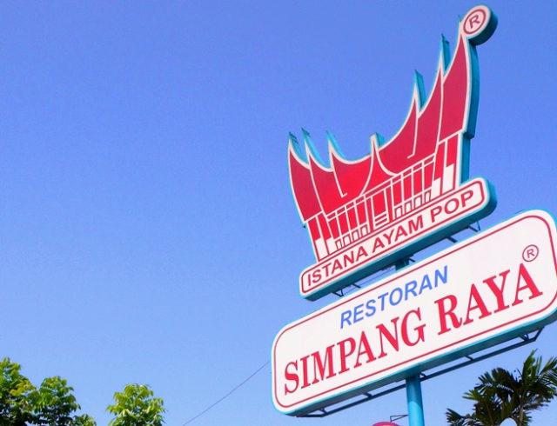
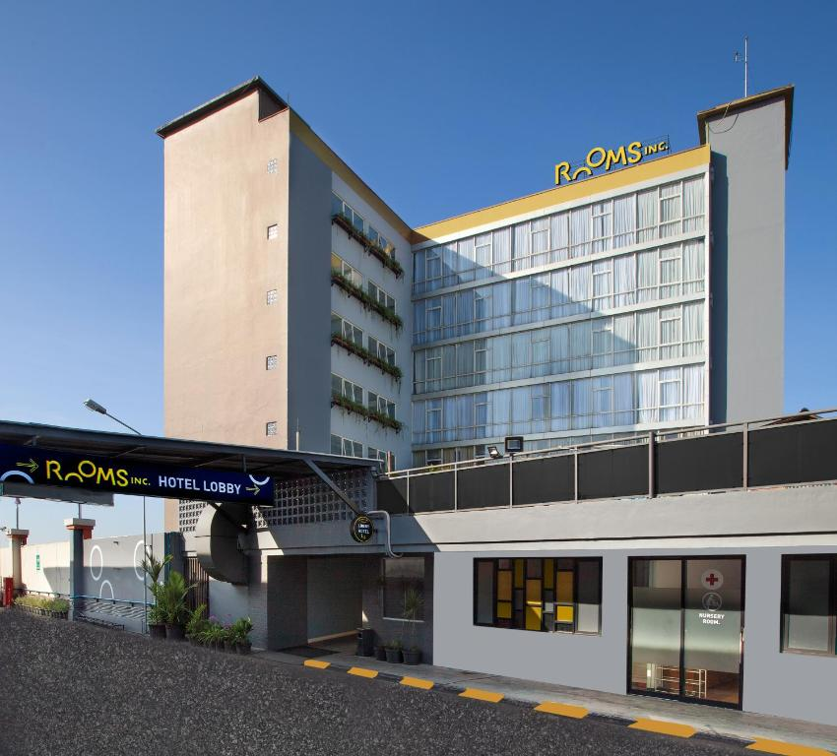
To get to the ROOMS Inc. Hotel at BTC Mall Bandung, ask the driver to stop at Simpang Raya Restaurant (before the ASTON hotel), then cross the road towards BTC Mall.
Rooms Inc. Hotel address:
Jl. Dr. Djunjunan No. 143-149

Slide 7
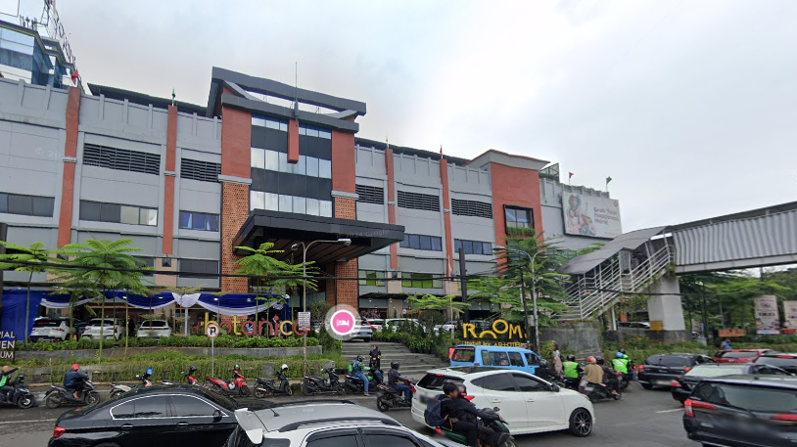
Front view of BTC Mall, ROOM Inc hotel is located behind the mall.
Rooms Inc. Hotel address: Jl. Dr. Djunjunan No.143-149

Slide 8


2. Whoosh High-Speed Train :

Slide 9
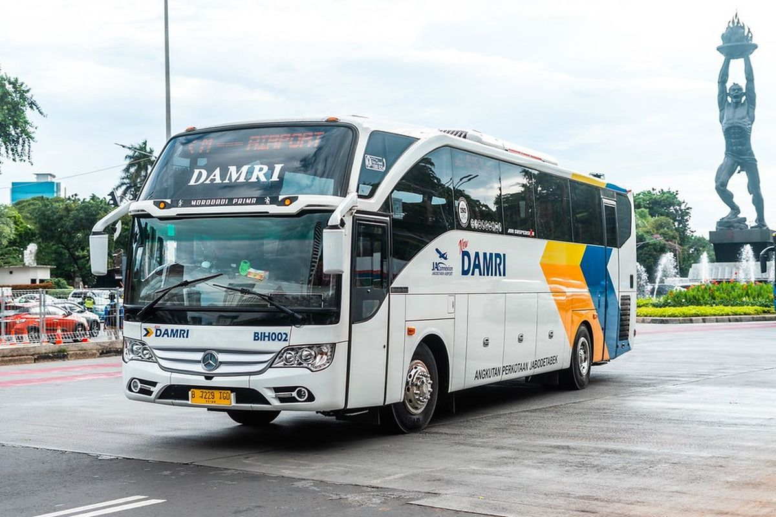
After reaching the ARRIVAL TERMINAL, exit through GATE 5 then turn left.
Then exit via T3 EXIT and get to the DAMRI bus pool.
You can pay cash while on the bus and are free to choose any available seat.
DAMRI bus ticket price: Rp. 80.000,-
Choose the DAMRI bus bound for
Whoosh Halim Station.
Departures start from 02:00 until 23:00 (local time)
every day, once every 1 hour.
Travel time is around 1 hour.

Slide 10
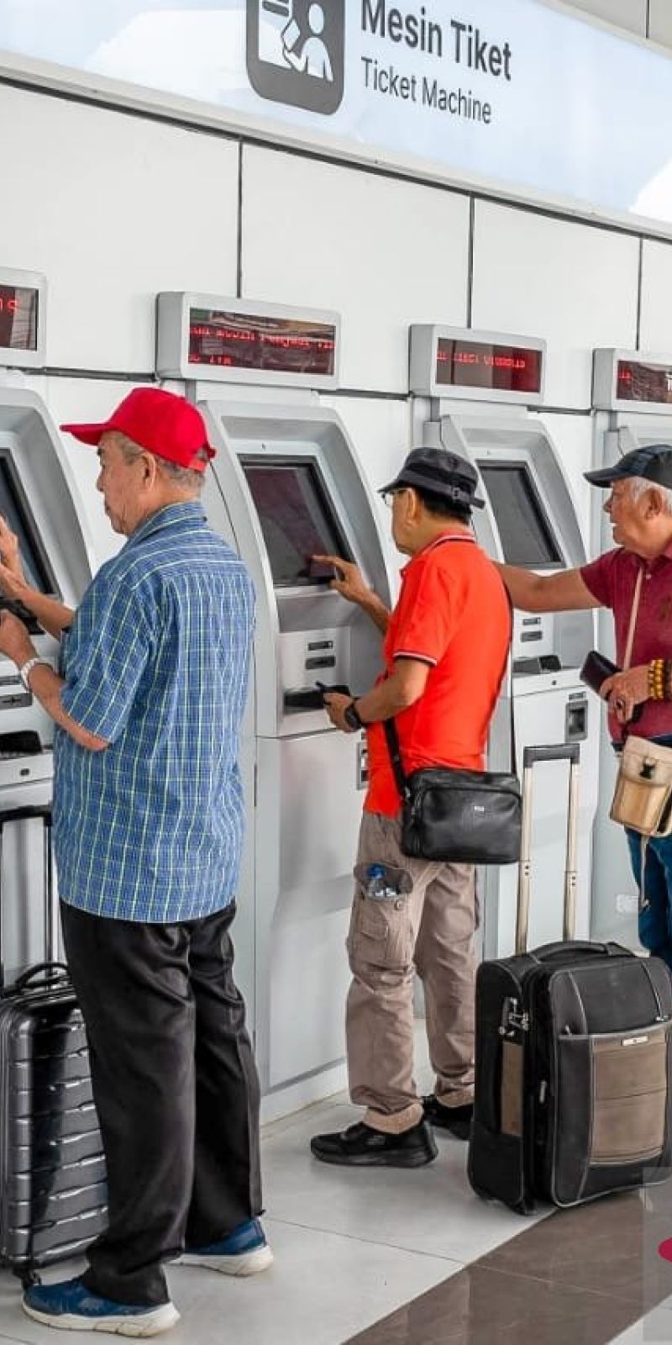
At Whoosh Halim Station, order tickets to Padalarang.
Whoosh ticket prices are between Rp. 150,000,- to Rp. 300,000,-
Choose Whoosh from Halim to Padalarang.
Departures start from 06:40 until 20:30 (local time).
Whoosh departs every 30 minutes to 1 hour.
Travel time is around 30 minutes.

Slide 11
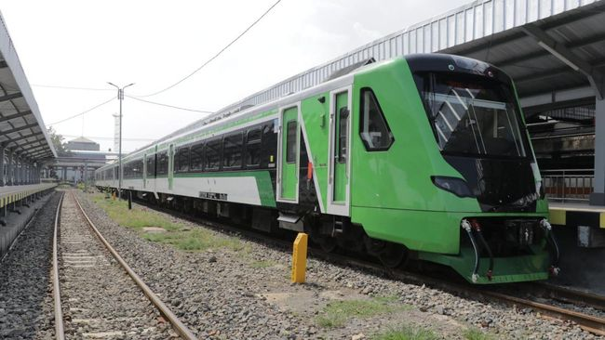
After arriving at Padalarang station, please take the Feeder train to Bandung station. There is no charge for the Feeder Train (free of charge).
The Feeder train is usually ready to wait when the Whoosh arrives.
Feeder trains operate from 07:00 to 19:45 (local time).
Travel time to Bandung station is around 20 minutes.

Slide 12


After arriving at Bandung station, please order a taxi or Grab car
to reach the hotels in Pasteur areas.
Taxi or Grab car can be found at the exit of Bandung train station.
The cost of a taxi or Grab car to the hotel is around Rp. 50.000,-
Address for Hotel ASTON Jl. Dr. Djunjunan No.162
Address for Hotel ROOM Inc Jl. Dr. Djunjunan No.143-149

Slide 13
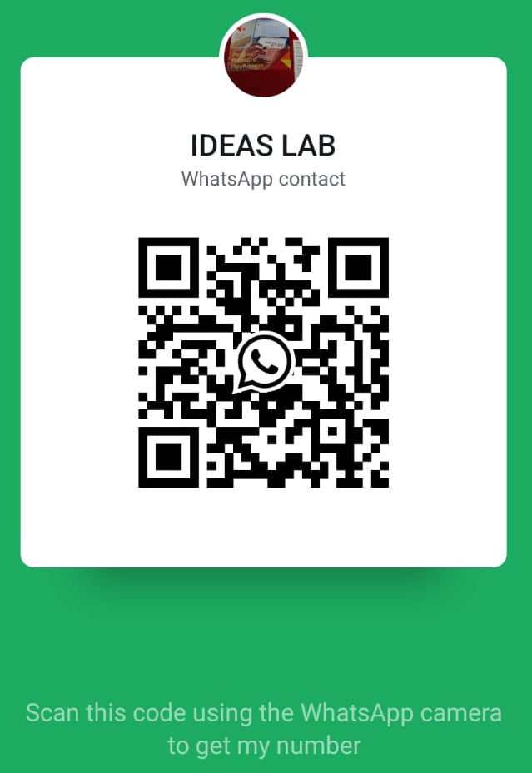
For further information please send e-mail to:
his2025@ideas-lab.org

